Slide 1




Refactoring: Improving the Quality of Existing Code
When and How to Refactor? Refactoring Patterns
High-Quality Code
SoftUni Team
Technical Trainers
Software University
http://softuni.bg

Slide 2

Table of Contents
What is Refactoring?
Refactoring Principles
Refactoring Process and Tips
Code smells
Refactoring Patterns
Refactoring Levels
Data level, statement level, method level, class level, system level refactorings, etc.

Slide 3

What is Refactoring?
Refactoring means "to improve the design and quality of existing source code without changing its external behavior".
Martin Fowler
A step by step process that turns the bad code into good code
Based on "refactoring patterns" → well-known recipes for improving the code

Slide 4
Code Refactoring
What is refactoring of the source code?
Improving the design and quality of existing source code without changing its behavior
Step by step process that turns the bad code into good code (if possible)
Why we need refactoring?
Code constantly changes and its quality constantly degrades (unless refactored)
Requirements often change and code needs to be changed to follow them

Slide 5

When to Refactor?
Bad smells in the code indicate need of refactoring
Refactor:
To make adding a new function easier
As part of the process of fixing bugs
When reviewing someone else's code
Have technical debt (or any problematic code)
When doing test-driven development
Unit tests guarantee that refactoring does not change the behavior
If there are no unit tests, write them

Slide 6
Refactoring: Main Principles
Keep it simple (KISS principle)
Avoid duplication (DRY principle)
Make it expressive (self-documenting, comments, etc.)
Reduce overall code (KISS principle)
Separate concerns (decoupling)
Appropriate level of abstraction (work through abstractions)
Boy scout rule
Leave your code better than you found it

Slide 7

Refactoring: The Typical Process
Save the code you start with
Check-in or backup the current code
Prepare tests to assure the behavior after the code is refactored
Unit tests / characterization tests
Do refactoring one at a time
Keep refactoring small
Don't underestimate small changes
Run the tests and they should pass / else revert
Check-in (into the source control system)

Slide 8

Refactoring Tips
Keep refactoring small
One at a time
Make a checklist
Make a "later" / TODO list
Check-in / commit frequently
Add tests cases
Review the results
Pair programming
Use tools (Visual Studio + add-ins / Eclipse + plugins / others)

Slide 9

Code Refactoring
Live Demo

Slide 10
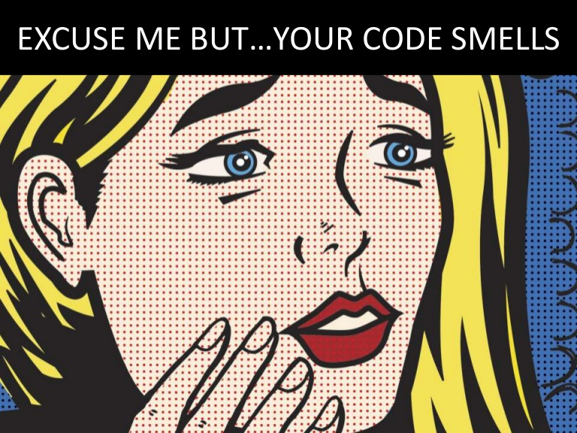
Code Smells

Slide 11

Code Smells
Code smells == certain structures in the code that suggest the possibility of refactoring
Types of code smells:
The bloaters
The obfuscators
Object-oriented abusers
Change preventers
Dispensables
The couplers

Slide 12

Code Smells: The Bloaters
Long method
Small methods are always better (easy naming, understanding, less duplicate code)
Large class
Too many instance variables or methods
Violating "Single Responsibility" principle
Primitive obsession (overused primitives)
Over-use of primitive values, instead of better abstraction
Can be extracted in separate class with encapsulated validation

Slide 13
Code Smells: The Bloaters (2)
Long parameter list (in / out / ref parameters)
May indicate procedural rather than OO style
May be the method is doing too much things
Data clumps
A set of data are always used together, but not organized together
E.g. credit card fields in the Order class
Combinatorial explosion
Ex. ListCars(), ListByRegion(), ListByManufacturer(), ListByManufacturerAndRegion(), etc.
Solution may be the Interpreter pattern (LINQ)

Slide 14
Code Smells: The Bloaters (3)
Oddball solution
A different way of solving a common problem
Not using consistency
Solution: Substitute algorithm or use an Adapter
Class doesn't do much
Solution: Merge with another class or remove
Required setup / teardown code
Requires several lines of code before its use
Solution: use parameter object, factory method, IDisposable

Slide 15
Code Smells: The Obfuscators
Regions
The intent of the code is unclear and needs commenting (smell)
The code is too long to understand (smell)
Solution: partial class, a new class, organize code
Comments
Should be used to tell WHY, not WHAT or HOW
Good comments: provide additional information, link to issues, explain an algorithm, explain reasons, give context
Link: Funny comments

Slide 16
Code Smells: The Obfuscators (2)
Poor / improper names
Should be proper, descriptive and consistent
Vertical separation
You should define variables just before first use to avoid scrolling
In JS variables are defined at the function start → use small functions
Inconsistency
Follow the POLA (Principle of Least Astonishment)
Inconsistency is confusing and distracting
Obscured intent
Code should be as expressive as possible

Slide 17
Code Smells: OO Abusers
Switch statement
Can be replaced with polymorphism
Temporary field
When passing data between methods
Class depends on subclass
The classes cannot be separated (circular dependency)
May break the Liskov substitution principle
Inappropriate static field
Strong coupling between static and callers
Static things cannot be replaced or reused

Slide 18
Code Smells: Change Preventers
Divergent change
A class is commonly changed in different ways / different reasons
Violates SRP (single responsibility principle)
Solution: extract class
Shotgun surgery
One change requires changes in many classes
Hard to find them, easy to miss some
Solution: move methods, move fields, reorganize the code

Slide 19
Code Smells: Change Preventers (2)
Conditional complexity
Cyclomatic complexity (number of unique paths that the code can be evaluated)
Symptoms: deep nesting (arrow code) and buggy if-s
Solutions: extract method, "Strategy" pattern, "State" pattern, "Decorator"
Poorly written tests
Badly written tests can prevent change
Tight coupling

Slide 20
Code Smells: Dispensables
Lazy class
Classes that don't do enough to justify their existence should be removed
Every class costs something to be understood and maintained
Data class
Some classes with only fields and properties
Missing validation? Class logic split into other classes?
Solution: move related logic into the class

Slide 21
Code Smells: Dispensables (2)
Duplicated code
Violates the DRY principle
Result of copy-pasted code
Solutions: extract method, extract class, pull-up method, Template Method pattern
Dead code (code that is never used)
Usually detected by static analysis tools
Speculative generality
"Some day we might need this …"
The "YAGNI" principle

Slide 22
Code Smells: The Couplers
Feature envy
Method that seems more interested in a class other than the one it actually is in
Keep together things that change together
Inappropriate intimacy
Classes that know too much about one another
Smells: inheritance, bidirectional relationships
Solutions: move method / field, extract class, change bidirectional to unidirectional association, replace inheritance with delegation

Slide 23
Code Smells: The Couplers (2)
The Law of Demeter (LoD)
A given object should assume as little as possible about the structure or properties of anything else
Bad e.g.: customer.Wallet.RemoveMoney()
Indecent exposure
Some classes or members are public but shouldn't be
Violates encapsulation
Can lead to inappropriate intimacy

Slide 24
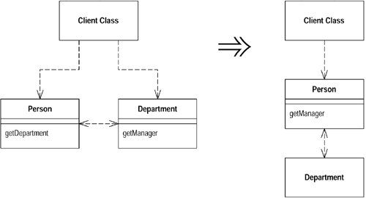
Code Smells: The Couplers (3)
Message chains
Something.Another.SomeOther.Other.YetAnother
Tight coupling between client and the structure of the navigation
Middle man
Sometimes delegation goes too far
Sometimes we can remove it or inline it
Tramp data
Pass data only because something else needs it
Solutions: Remove middle-man data, extract class

Slide 25
Code Smells: The Couplers (4)
Artificial coupling
Things that don't depend upon each other should not be artificially coupled
Hidden temporal coupling
Consecutively performed operations should not be guessed
E.g. pizza class should not know the steps of making pizza -> Template Method pattern
Hidden dependencies
Classes should declare their dependencies in their constructor
new is glue / Dependency Inversion principle

Slide 26



Refactoring Patterns
Well-Known Recipes for Improving the Code Quality

Slide 27
Rafactoring Patterns
When should we perform refactoring of the code?
Bad smells in the code indicate need of refactoring
Unit tests guarantee that refactoring preserves the behavior
Rafactoring patterns
Large repeating code fragments → extract duplicated code in separate method
Large methods → split them logically
Large loop body or deep nesting → extract method

Slide 28
Refactoring Patterns (2)
Class or method has weak cohesion → split into several classes / methods
Single change carry out changes in several classes → classes have tight coupling → consider redesign
Related data are always used together but are not part of a single class → group them in a class
A method has too many parameters → create a class to groups parameters together
A method calls more methods from another class than from its own class → move it

Slide 29
Rafactoring Patterns (3)
Two classes are tightly coupled → merge them or redesign them to separate their responsibilities
Public non-constant fields → make them private and define accessing properties
Magic numbers in the code → consider extracting constants
Bad named class / method / variable → rename it
Complex boolean condition → split it to several expressions or method calls

Slide 30
Rafactoring Patterns (4)
Complex expression → split it into few simple parts
A set of constants is used as enumeration → convert it to enumeration
Too complex method logic → extract several more simple methods or even create a new class
Unused classes, methods, parameters, variables → remove them
Large data is passed by value without a good reason → pass it by reference

Slide 31
Rafactoring Patterns (5)
Few classes share repeating functionality → extract base class and reuse the common code
Different classes need to be instantiated depending on configuration setting → use factory
Code is not well formatted → reformat it
Too many classes in a single namespace → split classes logically into more namespaces
Unused using definitions → remove them
Non-descriptive error messages → improve them
Absence of defensive programming → add it

Slide 32
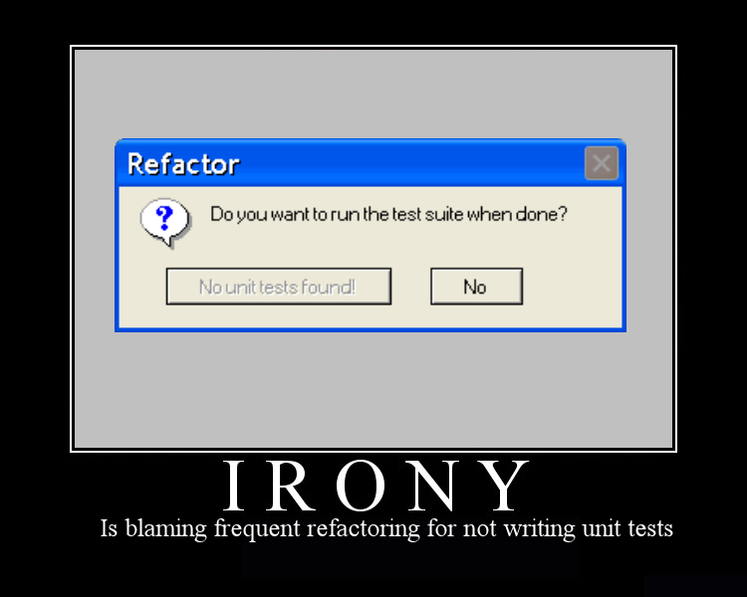
Refactoring Levels

Slide 33
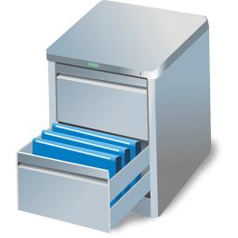

Data-Level Refactoring
Replace a magic number with a named constant
Rename a variable with more informative name
Replace an expression with a method
To simplify it or avoid code duplication
Move an expression inline
Introduce an intermediate variable
Introduce explaining variable
Convert a multi-use variable to a multiple single-use variables
Create separate variable for each usage

Slide 34
Data-Level Refactoring (2)
Create a local variable for local purposes rather than a parameter
Convert a data primitive to a class
Additional behavior / validation logic (money)
Convert a set of type codes (constants) to enum
Convert a set of type codes to a class with subclasses with different behavior
Change an array to an object
When you use an array with different types in it
Encapsulate a collection

Slide 35

Statement-Level Refactoring
Decompose a boolean expression
Move a complex boolean expression into a well-named boolean function
Use break or return instead of a loop control variable
Return as soon as you know the answer instead of assigning a return value
Consolidate duplicated code in conditionals
Replace conditionals with polymorphism
Use null-object design pattern instead of checking for null

Slide 36

Method-Level Refactoring
Extract method / inline method
Rename a method
Convert a long routine to a class
Add / remove parameter
Combine similar methods by parameterizing them
Substitute a complex algorithm with simpler
Separate methods whose behavior depends on parameters passed in (create new ones)
Pass a whole object rather than specific fields
Encapsulate downcast / return interface types

Slide 37
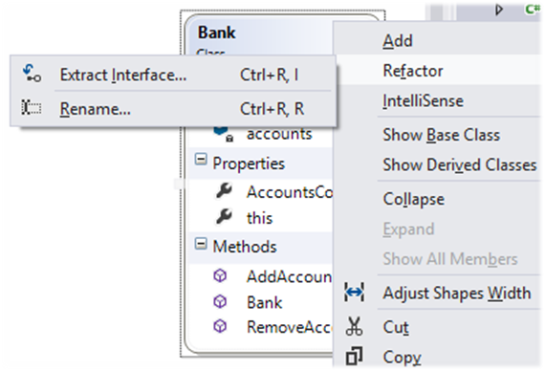
Class-Level Refactoring
Change a structure to class and vice versa
Pull members up / push members down the hierarchy
Extract specialized code into a subclass
Combine similar code into a superclass
Collapse hierarchy
Replace inheritance with delegation
Replace delegation with inheritance

Slide 38
Class Interface Refactorings
Extract interface(s) / keep interface segregation
Move a method to another class
Split a class / merge classes / delete a class
Hide a delegating class
A calls B and C when A should call B and B call C
Remove the man in the middle
Introduce (use) an extension class
When you have no access to the original class
Alternatively use the Decorator pattern

Slide 39
Class Interface Refactoring (2)
Encapsulate an exposed member variable
Always use properties
Define proper access to getters and setters
Remove setters to read-only data
Hide data and routines that are not intended to be used outside of the class / hierarchy
private -> protected -> internal -> public
Use strategy to avoid big class hierarchies
Apply other design patterns to solve common class and class hierarchy problems (Façade, Adapter, etc.)

Slide 40
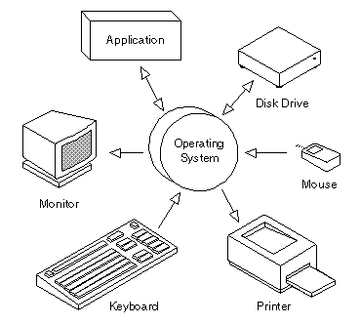
System-Level Refactoring
Move class (set of classes) to another namespace / assembly
Provide a factory method instead of a simple constructor / use fluent API
Replace error codes with exceptions
Extract strings to resource files
Use dependency injection
Apply architecture patterns

Slide 41

Refactoring: Improving the Quality of Existing Code
Exercises in Class

Slide 42
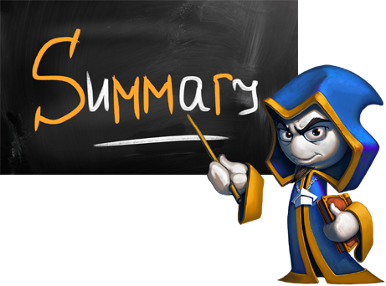
Summary
Refactoring
Data-level
Statement-level
Method-level
Class-level
System-level
Refactoring Patterns

Slide 43









Refactoring: Improving the Quality of Existing Code
http://softuni.org/courses/high-quality-code

Slide 44

License
This course (slides, examples, demos, videos, homework, etc.) is licensed under the "Creative Commons Attribution-NonCommercial-ShareAlike 4.0 International" license
Attribution: this work may contain portions from
"Fundamentals of Computer Programming with C#" book by Svetlin Nakov & Co. under CC-BY-SA license
"C# Part I" course by Telerik Academy under CC-BY-NC-SA license

Slide 45






Free Trainings @ Software University
Software University Foundation – softuni.org
Software University – High-Quality Education, Profession and Job for Software Developers
softuni.bg
Software University @ Facebook
facebook.com/SoftwareUniversity
Software University @ YouTube
youtube.com/SoftwareUniversity
Software University Forums – forum.softuni.bg

